Slide 2
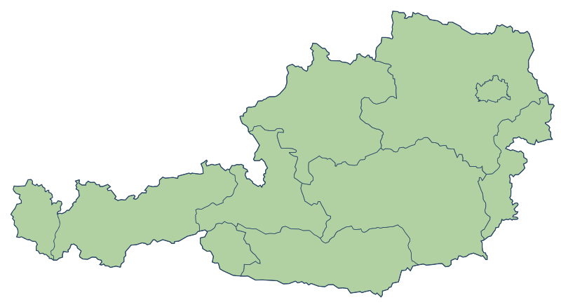
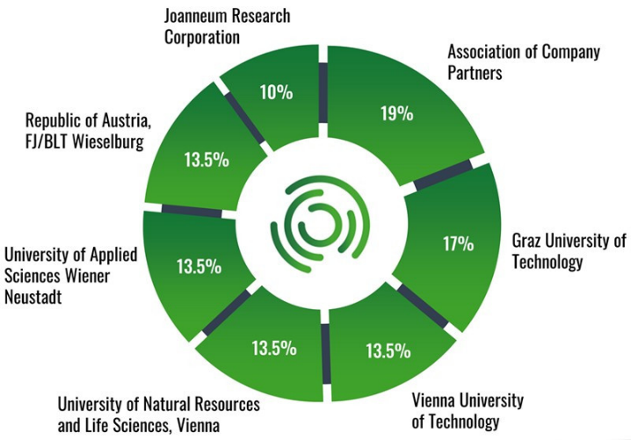
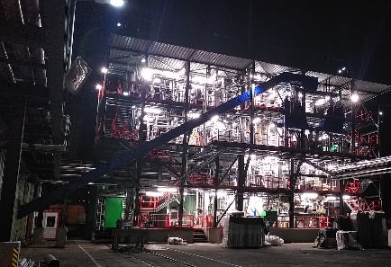
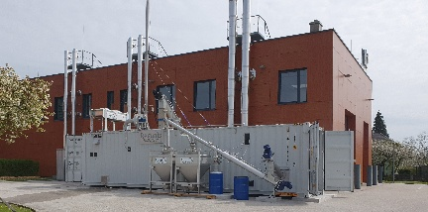
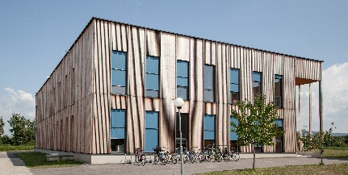
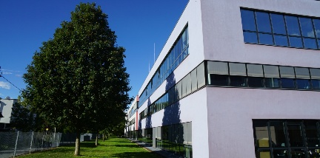
BEST – Bioenergy and Sustainable Technologies
Research centre jointly addressing circular economy & renewable energy systems
Human resources: > 100 employees
Experience: > 20 years
Annual turnover: ~ 12 mio €
Vienna
Wieselburg
Tulln
Graz, Headquarters

Slide 3
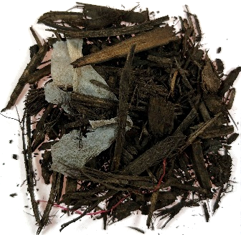
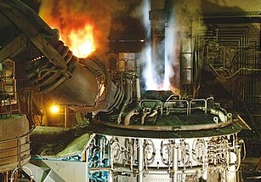
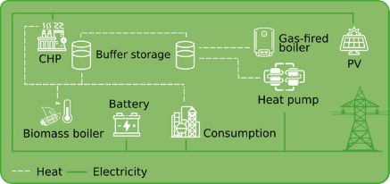

5 challenges with one overall goal
Changing the Carbon Game
Fossil Carbon substitution
Carbon and material recycling
CO₂ utilization and valorisation
Decentral energy and resource systems
CO₂
Increased automation through
Digitalisation and AI

Slide 4
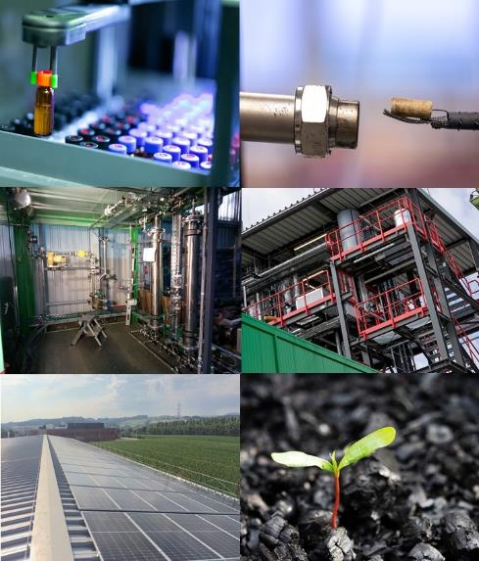
Unique R&D infrastructure from lab to pilot and demonstration-scale
Green Carbon Lab
  Pyrolysis system from Lab to Pilot scale
  Feedstock, process and product development and characterisation
Syngasplattform Vienna
  1 MW Syngas producer for biomass, residues and waste fractions
  Barrel / day Fischer-Tropsch Pilot (~ 250 kW)
  Coupled synthesis technologies (FT, mixed alcohols, …) in lab scale
Biotechlab
  Fermentation systems in variable scale (Gas- and electrofermentation)
  Lab- and pilot systems for development of algal based biorefineries
Microgrid Lab
  Biomass boiler, heat pump, absorption cooling, buffer storage
  PV and battery, charging station, (H₂ infrastructure currently in planning)
  Testing environment for holistic controls
Notes:
Im Text nicht aufs woher kommen wir vergessen: pure biomass to … usw

Slide 5
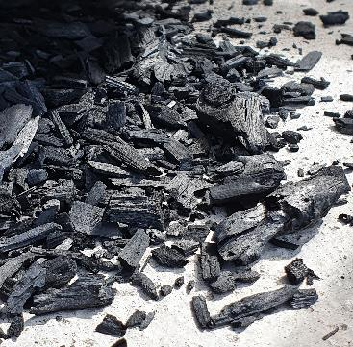
Hands-on GreenCarbon & Energy im GreenCarbon Lab @ BEST

Slide 6
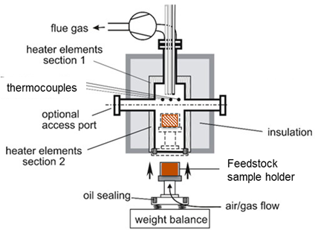
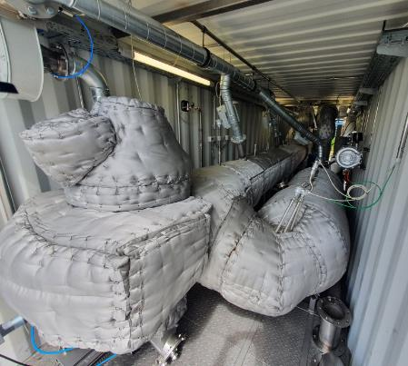
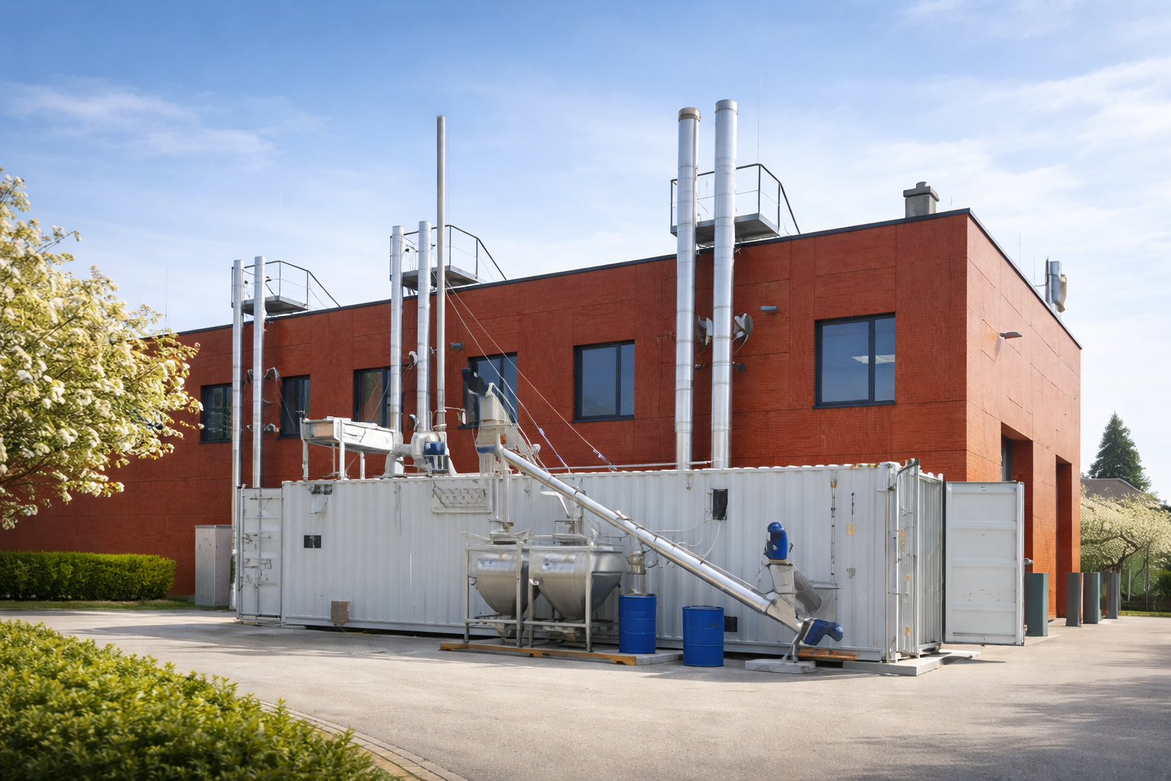
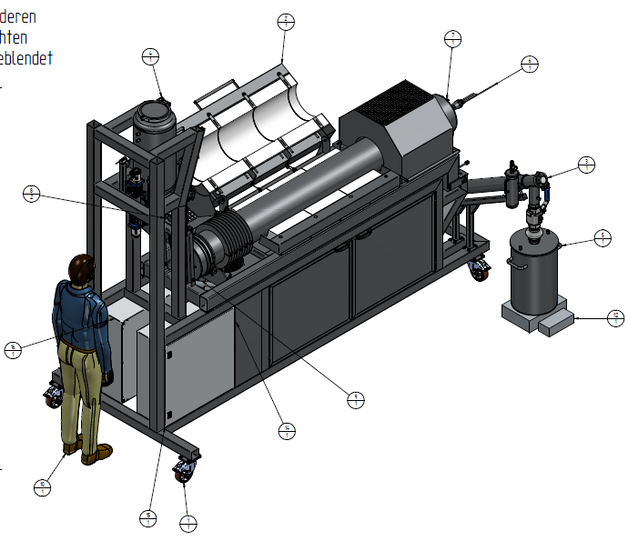
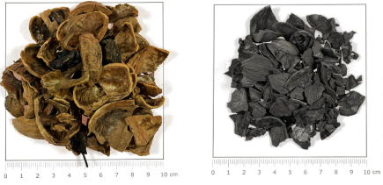
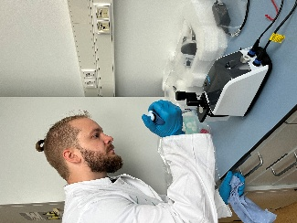
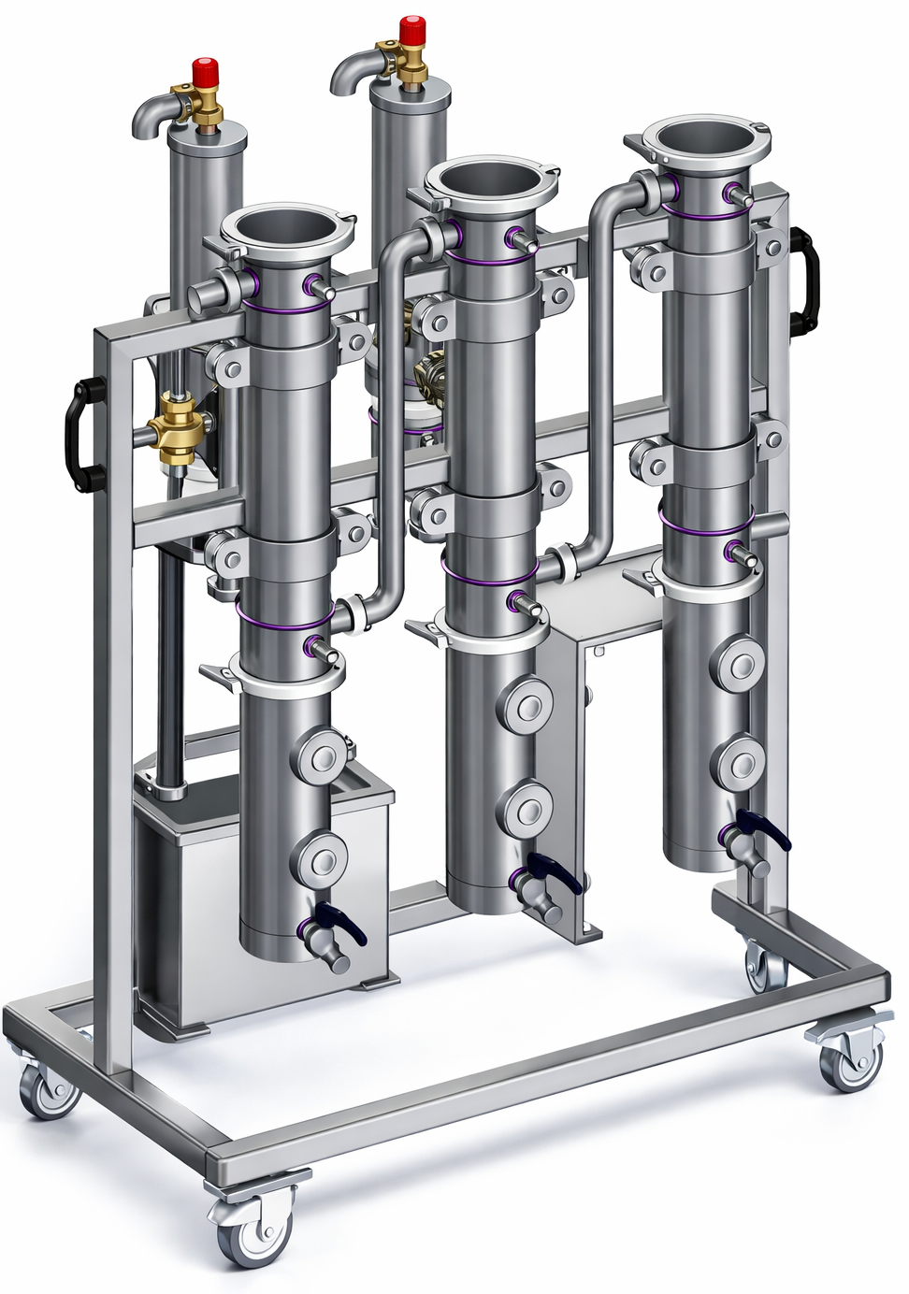
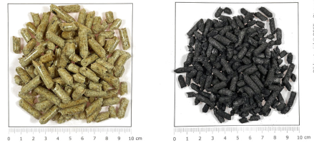
Application-oriented research infrastructure in BEST´s GreenCarbon Lab
GCL^{Flex}400 lab-scale batch reactor
sample size 400 g
GCL^{Pyro}90k continuous pilot unit
90 kg/h input capacity
feedstock analyses
pre-testing
batch-testing
process innovation
feasibility
process optimization
Green Carbon design
scale-up validation application test batches
integration, demonstration
Laboratory
sample size 50 mg
GCL^{Pyro}2k continuous lab unit
2 kg/h input capacity
defined residence time, temperature, atmosphere
mass-, energy-, carbon-balance
Bio-oil fractionation

Slide 7
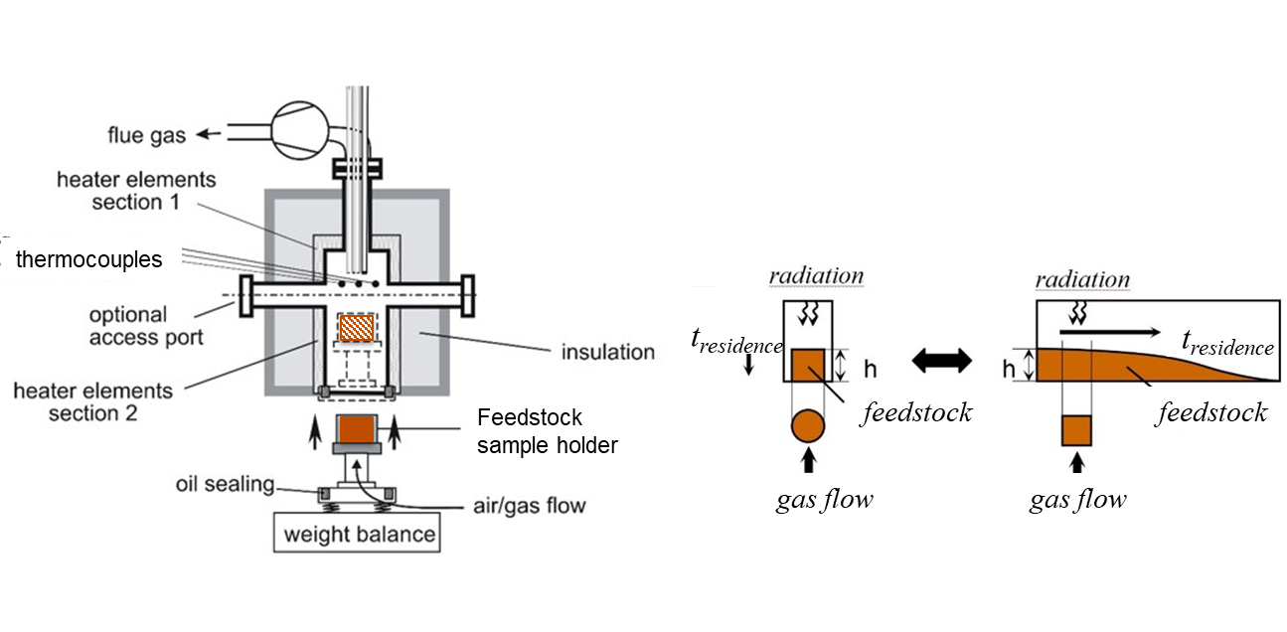
GreenCarbon Lab – flex400 pyrolysis – gasification - combustion
Batch reactor
up to 400g feedstock
1000 °C
heating rate up to 20°C/min
variable gas atmosphere
feedstock behaviour – first product samples – process innovation tests

Slide 8


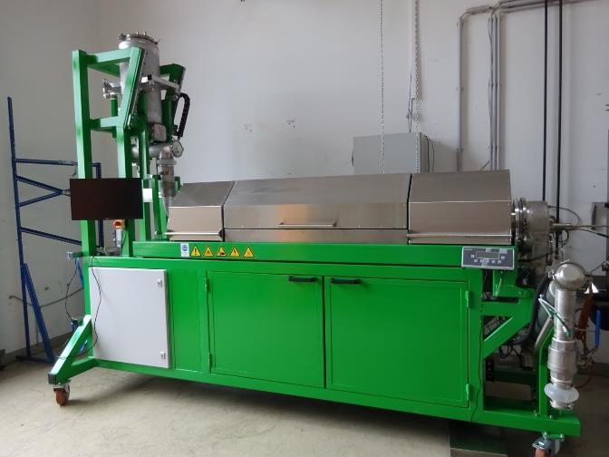
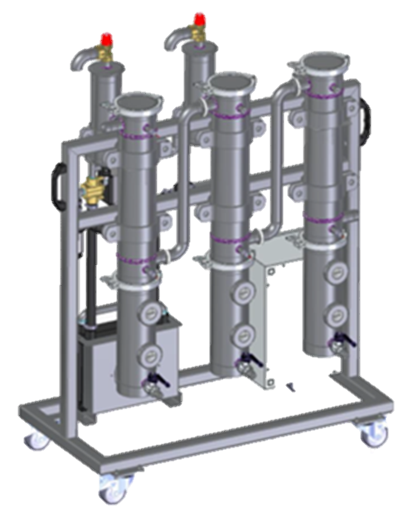
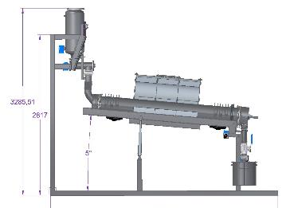
GreenCarbon Lab – GCL_{pyro}2k
Pyrolysis – Laboratory Plant
Electrically heated rotary kiln
0,5 – 1 kg char/h
3 temperature zones
200° - 1100°C
Variable residence time
Defined gas atmospheres
Notes:
Process variation
Feedstock testing
Product sample production
Mass- and energy balances

Slide 9
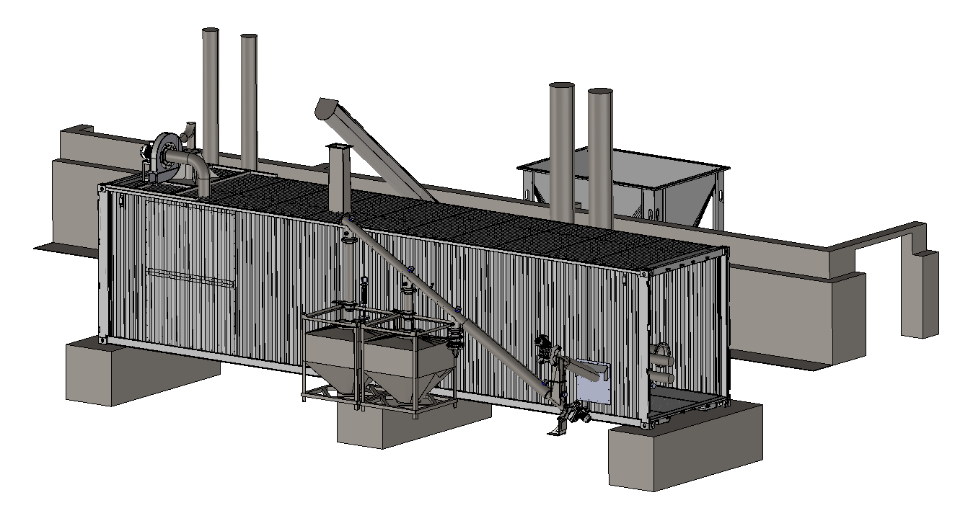

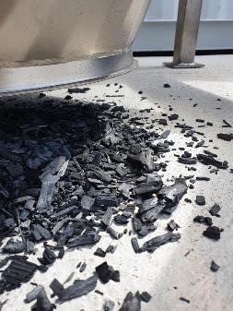
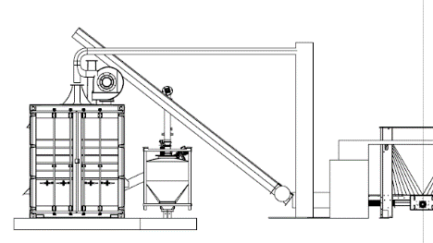

GreenCarbon Lab – GCL_{pyro}90k
GCL_{pyro}90k
Pyrolysis – Pilot Plant
25 – 30 kg char /h
3 temperature zones
300° - 800°C
Defined process conditions
Notes:
Validation of biochar-„recipes“
Pilot testing for biochar applications
Long-term tests (24/7)

Slide 10

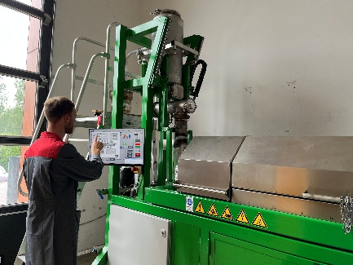
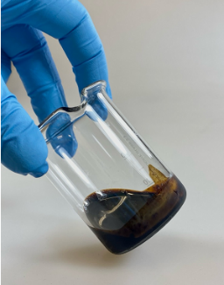
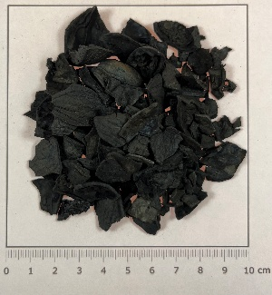
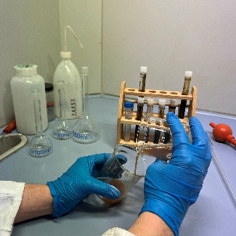
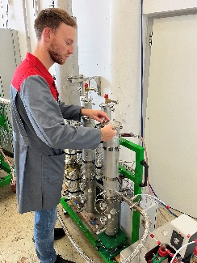
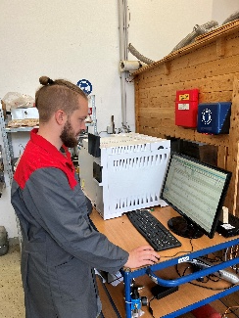
TestBe4Invest Process
1
2
3
4
Feedstock-Screening
Understanding the input defines the outcome
Labor
Feedstock analytics & raw material checklist
Lab-Scale Feasibility Study
Small-scale real-world tests
GCL^{pyro}2k / GCL^{Flex}400
Mass-, Energy-, C-balance,
Biochar characterisation
Scale-up & Validation
On the road to application scale
GCL^{pyro}90k
Biochar Test-Batches up to 1 t,
validation
Regulations & Integration
Understanding the regulatory and integration framework
Individual Consulting
Regulatory requirments & Integration
Residue suitable for pyrolysis?
Quantification of Outputs (products, electricity/heat, …)
Nutzungsspezifische Biokohle bis zu 1 t
Individual e.g. Support Technolgy-Evaluation / plant approval procedures

