Slide 1
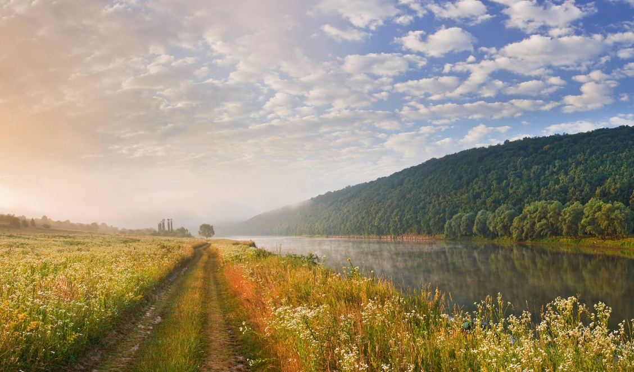
Austrian National Stakeholder Workshop
Manuel Schwabl & Elisabeth Wopienka,
BEST Bioenergy and Sustainable Technologies
IEA Bioenergy Task 34 NTL Austria
IEA Bioenergy Task 34- DTL01.07.2026, Wieselburg

Slide 2
Programm Overview
(subject to short-term changes)
09:30 – Arrival & Registration
10:00 – Welcome & Introduction of IEA Bioenergy Task 34 – DTL
11:30 – Stakeholder Pitches
13:00 (approx.) – Lunch & Learn
14:30 – Departure Erlaufschlucht
15:00 (approx.) – Networking Hike: Erlaufschlucht (ca. 2 hours)
(weather-dependent)

Slide 3
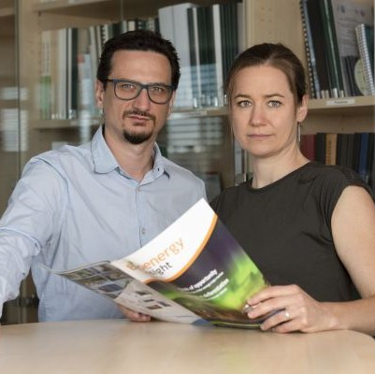
Manuel Schwabl
Manuel.schwabl@best-research.eu
Elisabeth Wopienka
Elisabeth.wopienka@best-research.eu
https://www.best-research.eu
https://task34.ieabioenergy.com/

